Slide 1
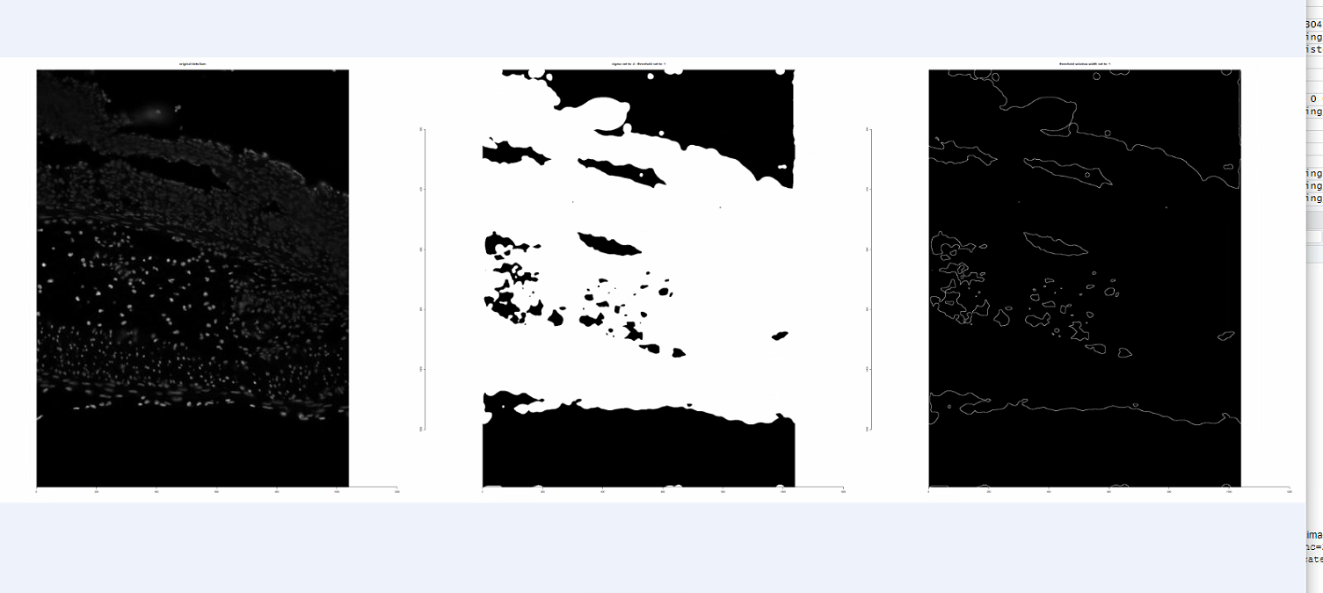
Adapting threshold – von(xt-1)*-1 und sigma 4, threshold 1, a_threshold window= 1

